Slide 1
Welcome to
R³
Driving Sustainability
April 2025
1

Slide 2


Company Purpose
Accelerate transition to sustainable lifestyle by building recycling technologies for everyday products
2

Slide 3
Problems
Shortcomings to Current Solutions
01
Current Ink Removal Wastes Ink Instead of Recovering It
02
Paper Recycling is Inefficient & Wasteful
03
Ink Costs are High & Unsustainable
04
No Scalable Ink-Recycling Technology Exists
3

Slide 4




Solutions
R³ is a reverse printing company that enables individuals to lead sustainable and waste-free lifestyles by recycling papers and inks.
First Scalable
Ink-Recycling
Printer
Ink Recovery &
Reuse
Instant Paper
Reusability
Smart Printing
4

Slide 5
Why Now?
Reverse printing is the process of removing ink from a printed
paper, allowing you to recover your ink and paper for future reuse. This results in significant cost savings, reduced waste, and a more sustainable printing ecosystem.
By using reverse printing, you cut down on printing costs, reduce
environmental impact and create a more sustainable way to print. With reverse printing, you will receive following benefits:
• Massive cost savings
• No need to reorder ink or paper
• Lower carbon footprint
• Optimized ink removal
5

Slide 6
Market Potential
Circular Economy: $556B (2023) → $1.90 T (2033) (Yahoo Finance)
Ink Industry: $19.0B (2022) → $28.6B (2028) (Markets and Markets)
Approximately 25% of the world’s waste annually is from businesses
Paper waste accounts for up to 40% of total waste in the US
The US generates approximately 96 million tons of packaging material waste annually
Target Customers:
Schools & Universities
Large Enterprises
Eco-conscious organizations
Target Key Trends:
Sustainability Regulations
Cost-cutting pressures
ESG Policies
Environmental Awareness
6
https://www.epa.gov/facts-and-figures-about-materials-waste-and-recycling/paper-and-paperboard-material-specific-data?utm_source=chatgpt.com#PaperTableandGraph

Slide 7
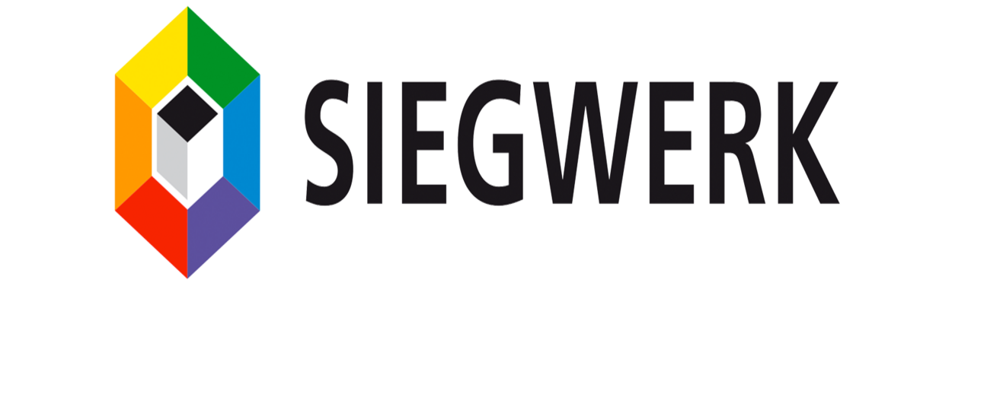
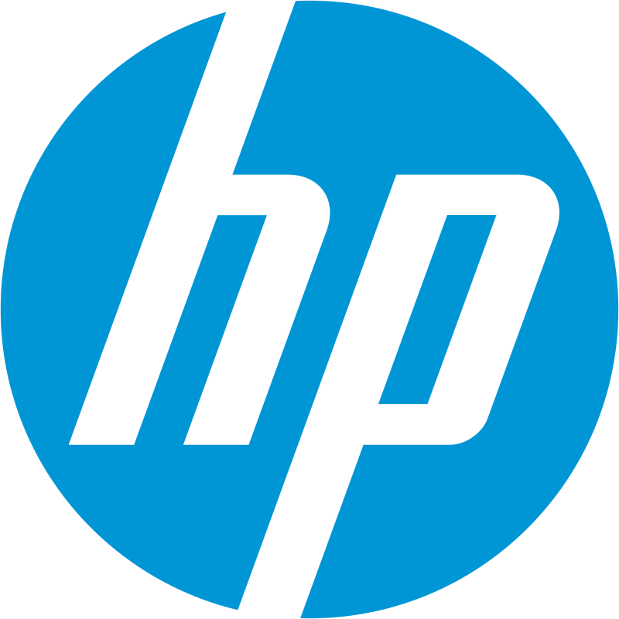
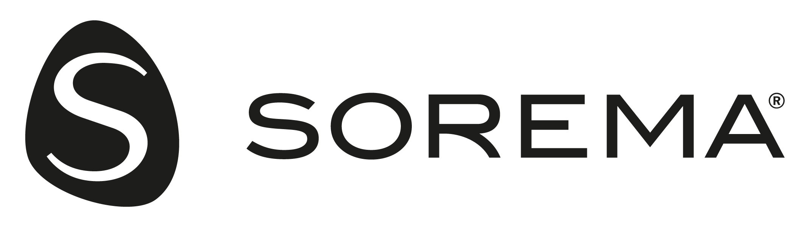

Develop ink solutions like de-inking technologies that improve paper
recyclability
Working on recycling paper through de-printing
Industry leading market presence with high performing printers, inks, and financial capital
Focuses on advanced washing
systems for ink removal in plastic
recycling
Limits: No focus on ink recovery
Limit: No focus on recovering ink
Limit: Focuses on offering eco-friendly
cartridges, offering cost-per-page
subscription service
Limit: Washing systems use lots of hot water and chemicals on an industrial scale. Their focus is on plastic recycling, not paper
Competition
7

Slide 8









Business Model
User Acquisition
Conversion
Retention
Digital Marketing
Demonstration Programs
Community Building
Industry Events
Client's referrals
Award programs
Green Certifications
Publish success stories
Include more ink types
8
R3 is a reverse printing company aiming to accelerate transition to sustainable lifestyle by building recycling technologies for everyday products.

Slide 9
Our Team
Umer Ghaffar (CEO)
Undergraduate Student of Biomedical Engineering
Shivani Jariwala
Graduate Student of Software Engineering
Sania Bandekar
Undergraduate Student of Data Science
9

Slide 10
“Our aim is to be the leader of the global transition into sustainable technology lifestyles. To make that a reality, we have to adapt to the customer lifestyles of today, and convert daily tasks into something beyond themselves, for the planet.”
Our Vision
10

